Slide 1


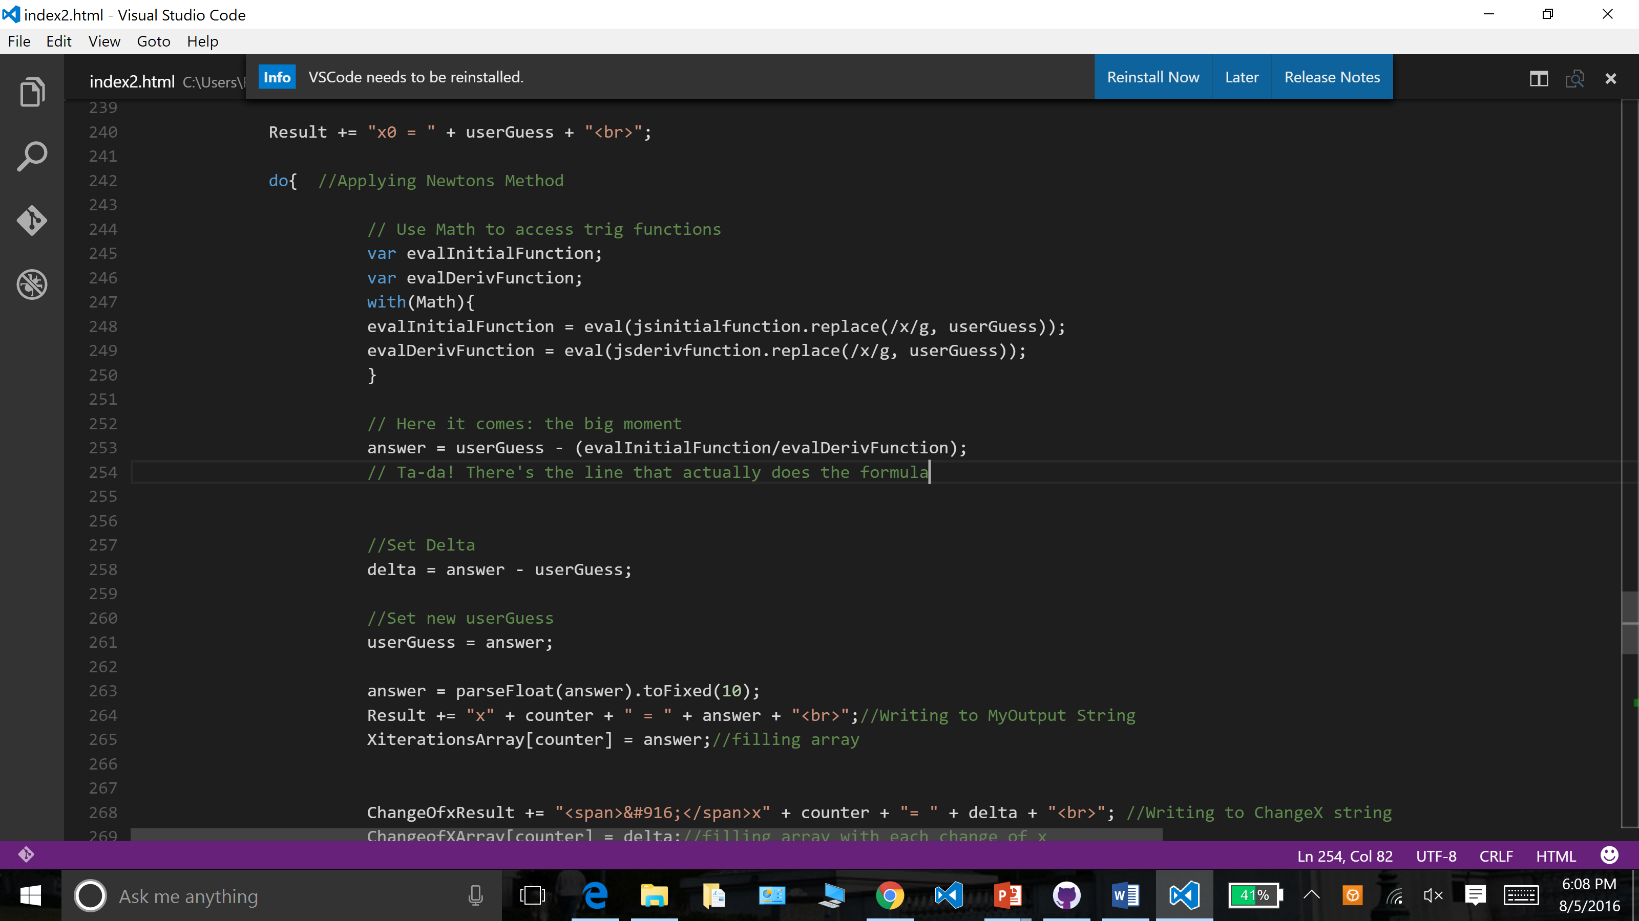
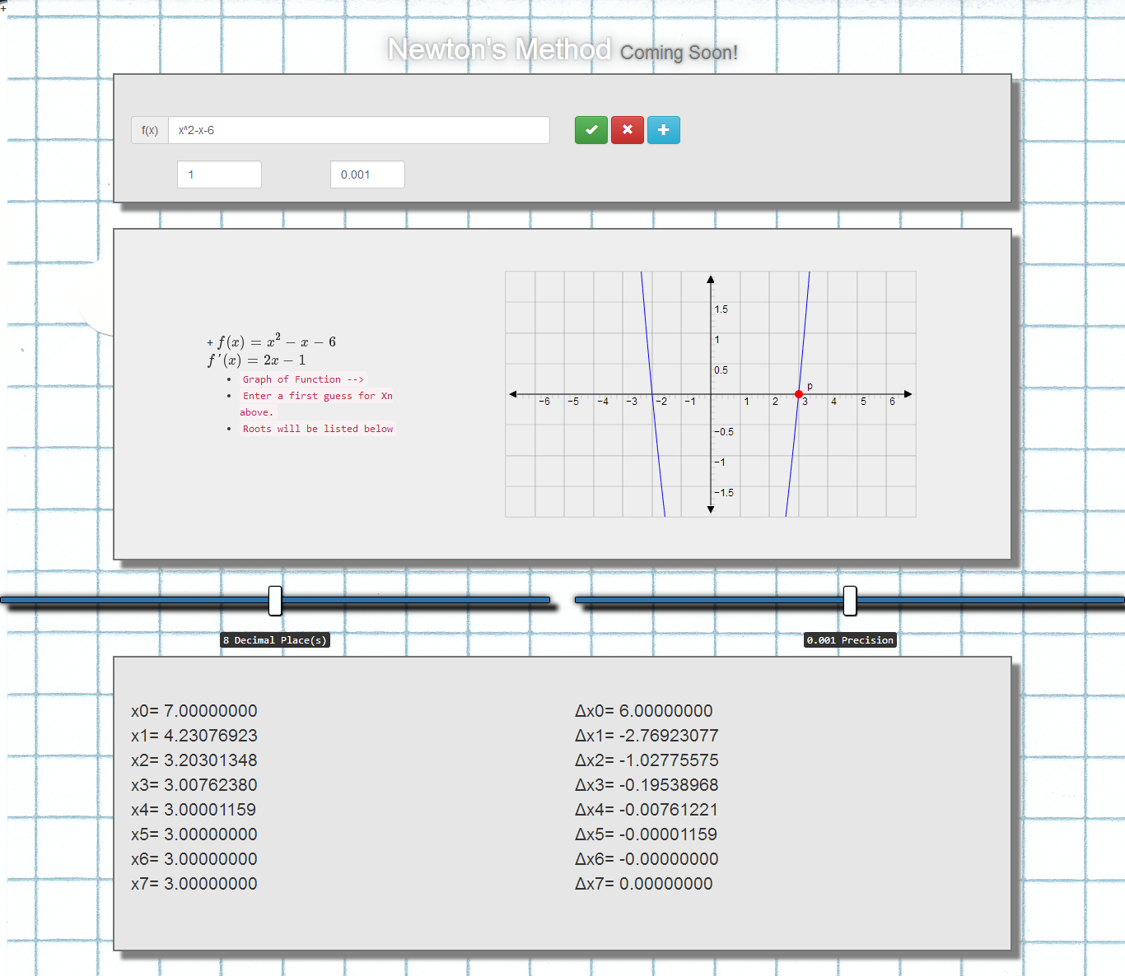
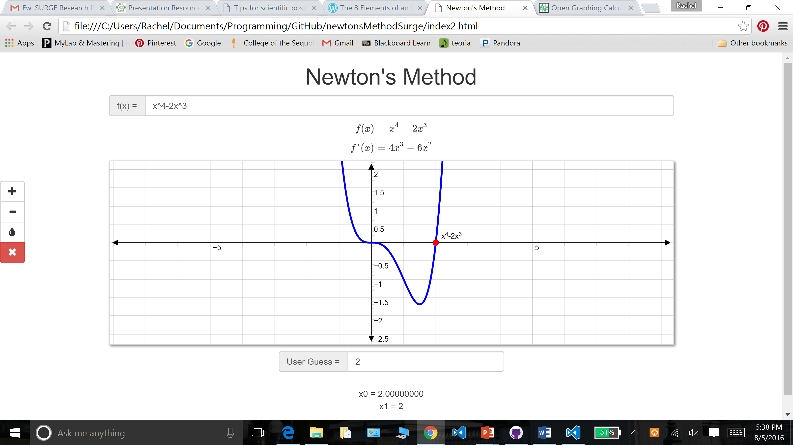
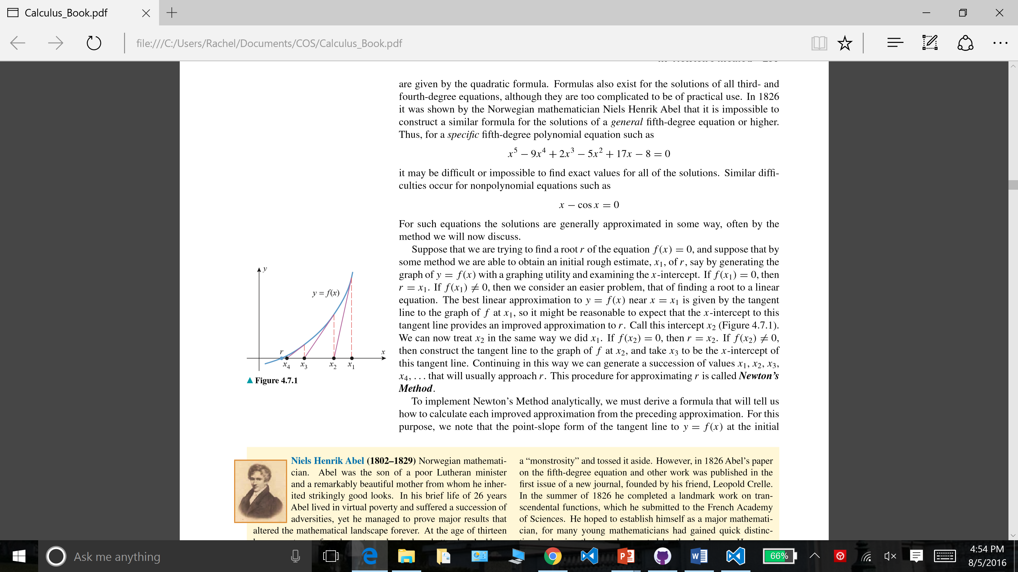
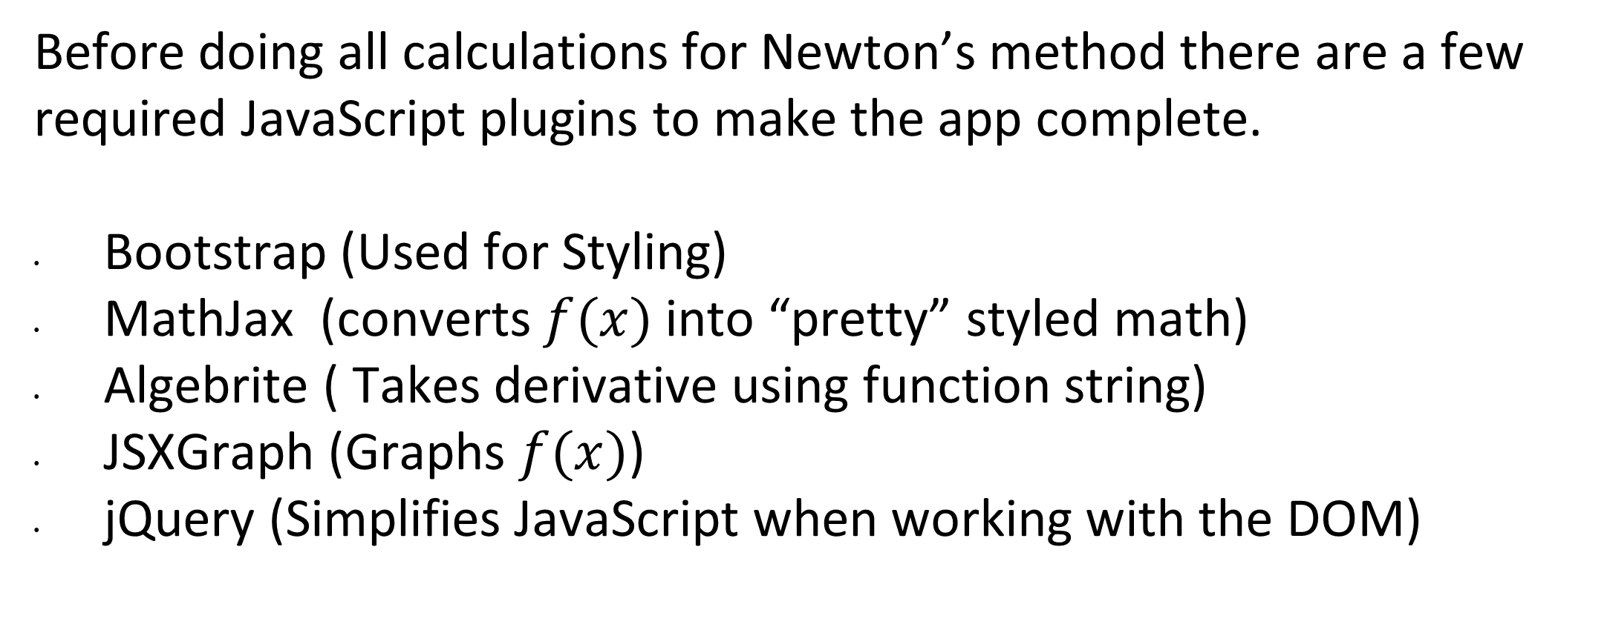
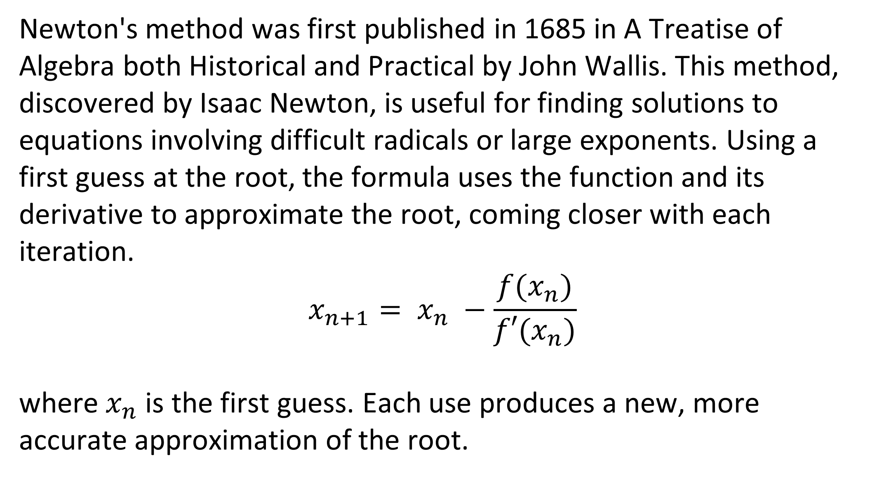
Newton's Method Calculator Cory Lewis and Rachel Owens
Introduction
Design
Calculations
Our project goal was to create a web app that can quickly output an approximation to the root of a function using Newton’s Method, introduced in our Calculus class. This would allow for users to bypass the tedious work of performing dozens of iterations by hand. This unique program allows users to enter a function and guess, and have the computer work through the iterations before presenting an answer. The difficulties building this program included designing a loop to properly handle the iterations, as well as formatting the graph and web page. We found that a do-while loop for the heart of the math calculations worked well, and allowed for us to control the number of iterations using the exit conditions. The final website also includes a graph to make it easier for users to visualize the function and make a sound initial guess.
Design Evolution
Version 1.5
A blend of the concepts from the prototype and concepts from the final piece. Our prototype was only for quadratics, and had no graph. This next version included a graph and sliders to change the accuracy and precision of the output.
Objectives
Gain exposure to JavaScript and jQuery.
Learn new skills and experience the application development cycle.
Become familiar with languages, programs, and existing libraries.
Design an efficient, effective, and useful web application.
Complete an internship with SURGE that focuses on the group experience.
Final Version
Shows typed function live below input box. When ENTER is pressed the graph fades in allowing the user to enter a first guess and see which critical value was found.
Additional Components
Before doing all calculations for Newton’s method there are a few required JavaScript plugins to make the app complete.
Bootstrap (Used for Styling)
MathJax (converts $f(x)$into “pretty” styled math)
Algebrite ( Takes derivative using function string)
JSXGraph (Graphs $f(x)$)
jQuery (Simplifies JavaScript when working with the DOM)
Background
Newton's method was first published in 1685 in A Treatise of Algebra both Historical and Practical by John Wallis. This method, discovered by Isaac Newton, is useful for finding solutions to equations involving difficult radicals or large exponents. Using a first guess at the root, the formula uses the function and its derivative to approximate the root, coming closer with each iteration.
$$x_{n+1}= x_{n} −\frac{f(x_{n})}{f′(x_{n})}$$
where $x_{n}$ is the first guess. Each use produces a new, more accurate approximation of the root.
Program Flow
1. User enters text
Display styled function
2. On Enter
Display derivative, graph, and guess input box
3. On Guess Enter
Convert string into JSMath, evaluate, and loop until the change is less than 0.001
4. Display iterations and graph final answer
Summary
We succeeded in programming a web application that uses Newton’s method to approximate roots. While we met our goal of outputting the iterations of answers, we were also able to add an interactive graph to give a visual aid for users. This experience allowed us to expand our knowledge of programming languages and libraries. We further reinforced our understanding of programming web apps through the process of developing our own.
Figure 1
Acknowledgements
Funding for this project was provided by the College of the Sequoias SURGE program, which is funded by the US Department of Education MSEIP grant #P120A130106. Thanks to Calculus by Antons, Bivens, and Davis for Figure #1. Special thanks to our advisor, Mr. Redden, for his knowledge and help.

